Slide 1


Internet Speed Analysis
The Fast, the Slow and the Eduroam
Isaac Chia, Shaun Guo, Rafael Laury, Beaudly Leriche, Levi Tucker
ECE 3600 Final Project
Spring 2023
Notes:
isaac or beaudly

Slide 2
Overview
Collect samples of download speed and upload speed for 2 on-campus locations and 1 off-campus location
Compare results for busy and non-busy hours
Analyze the trends and make observations
Notes:
isaac or beaudly

Slide 3

Method
Python script captures 20 samples of upload and download speeds using speedtest library
Present information in spreadsheet
Second Python script analyzes data & produces graphical representation (effective & average speed)
Notes:
raffy can talk about this because he did the script

Slide 4
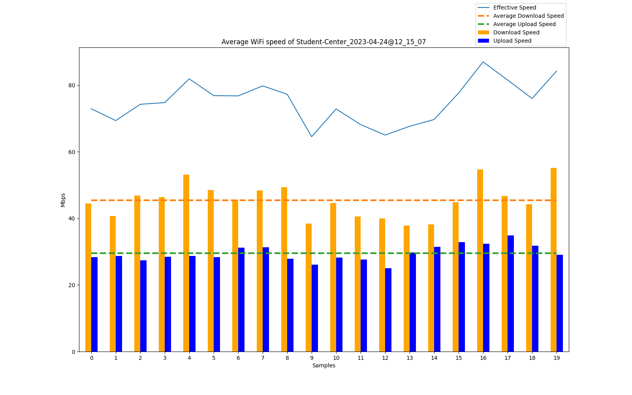
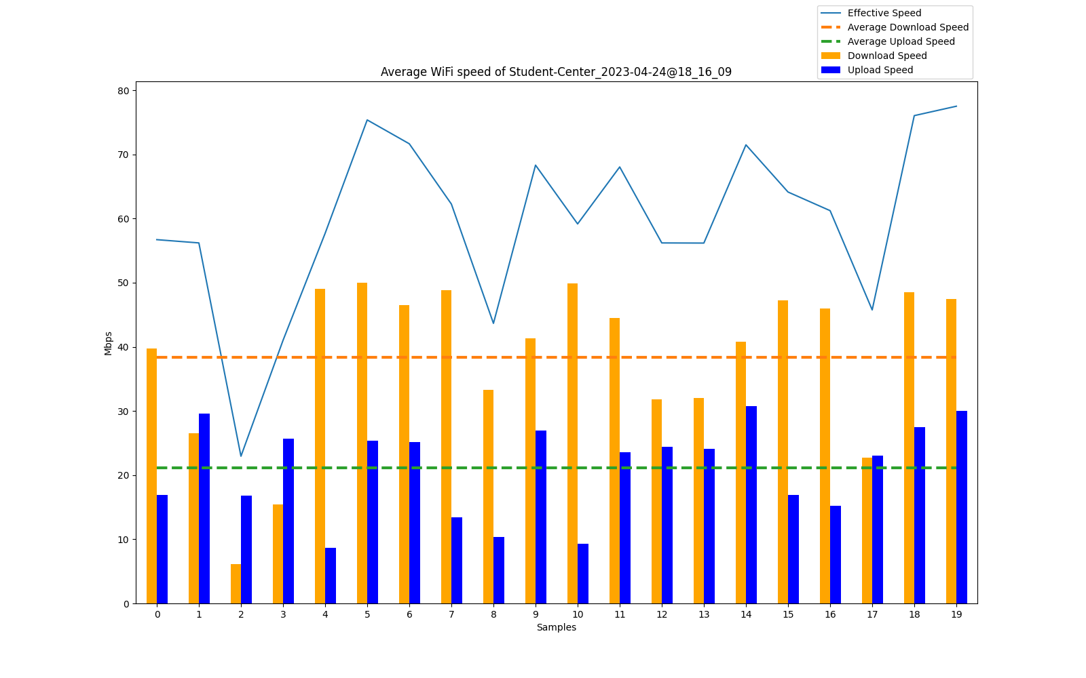
On Campus - Student Center
Figure 1a. Busy time
Figure 1b. Non-busy time
Notes:
isaac or beaudly

Slide 5
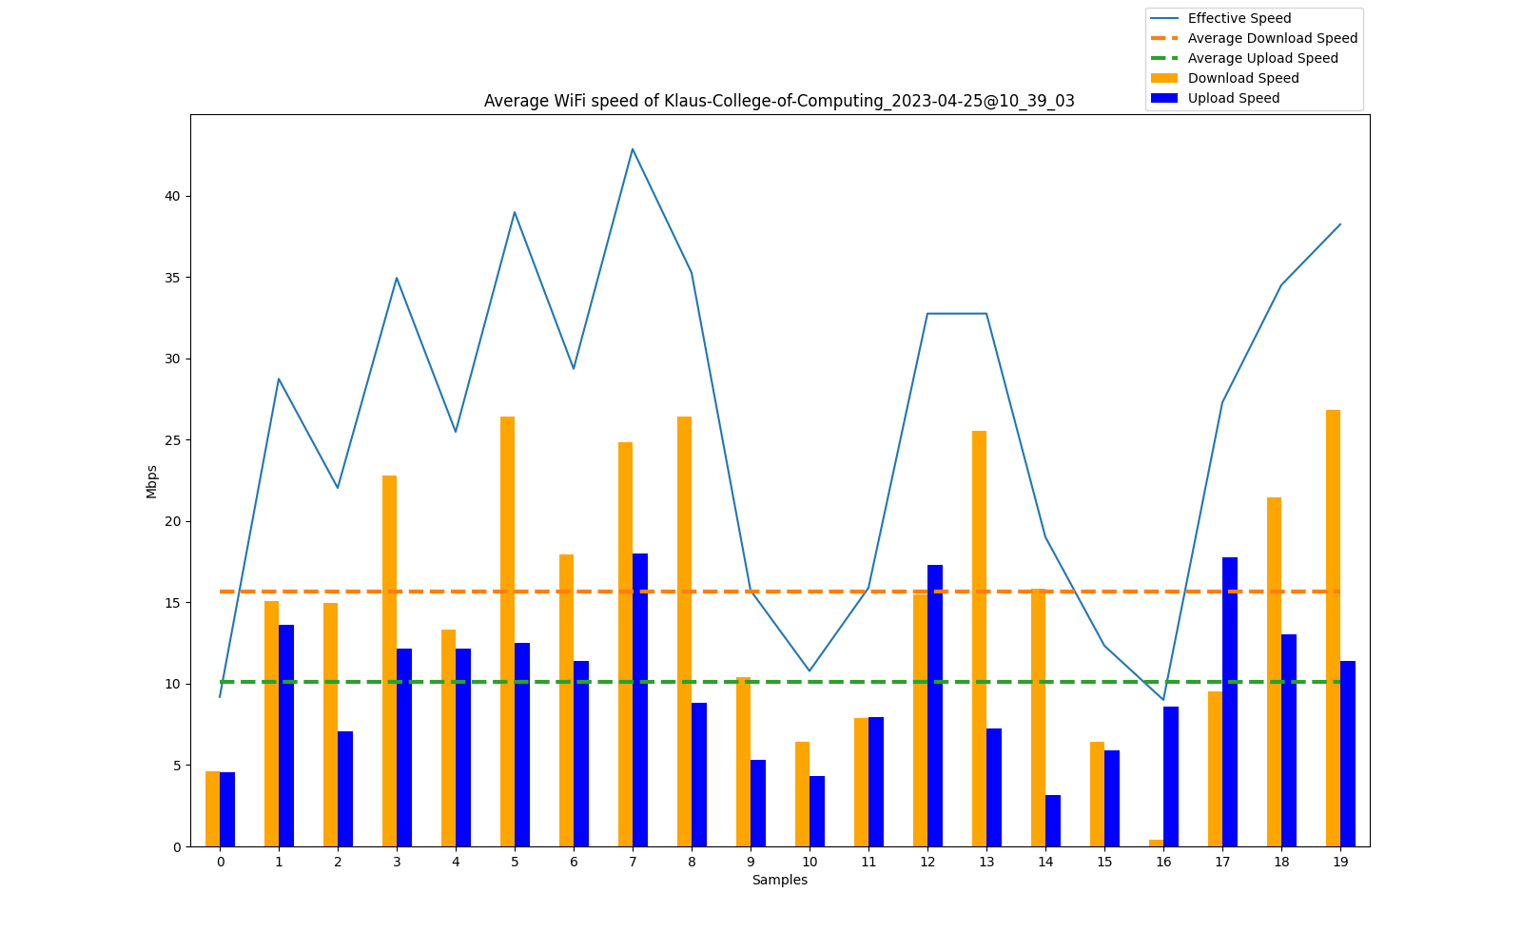
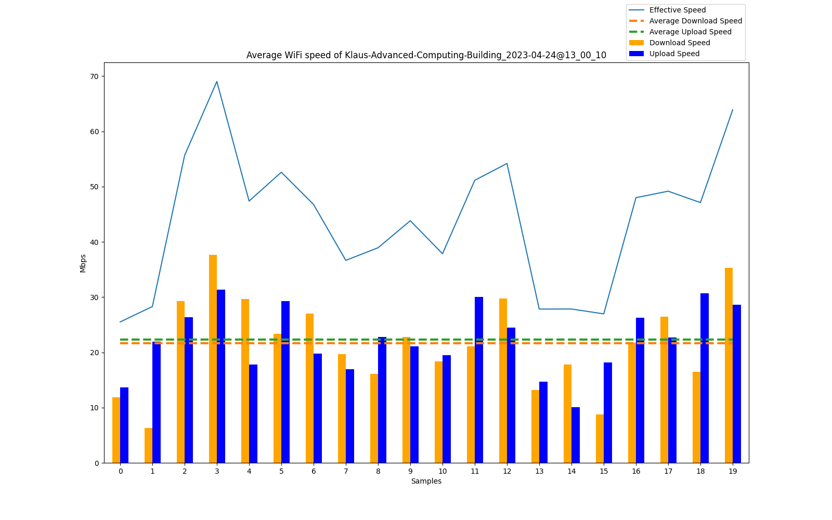
On Campus - Klaus
Figure 2a. Busy time
Figure 2b. Non-busy time
Notes:
isaac or beaudly

Slide 6
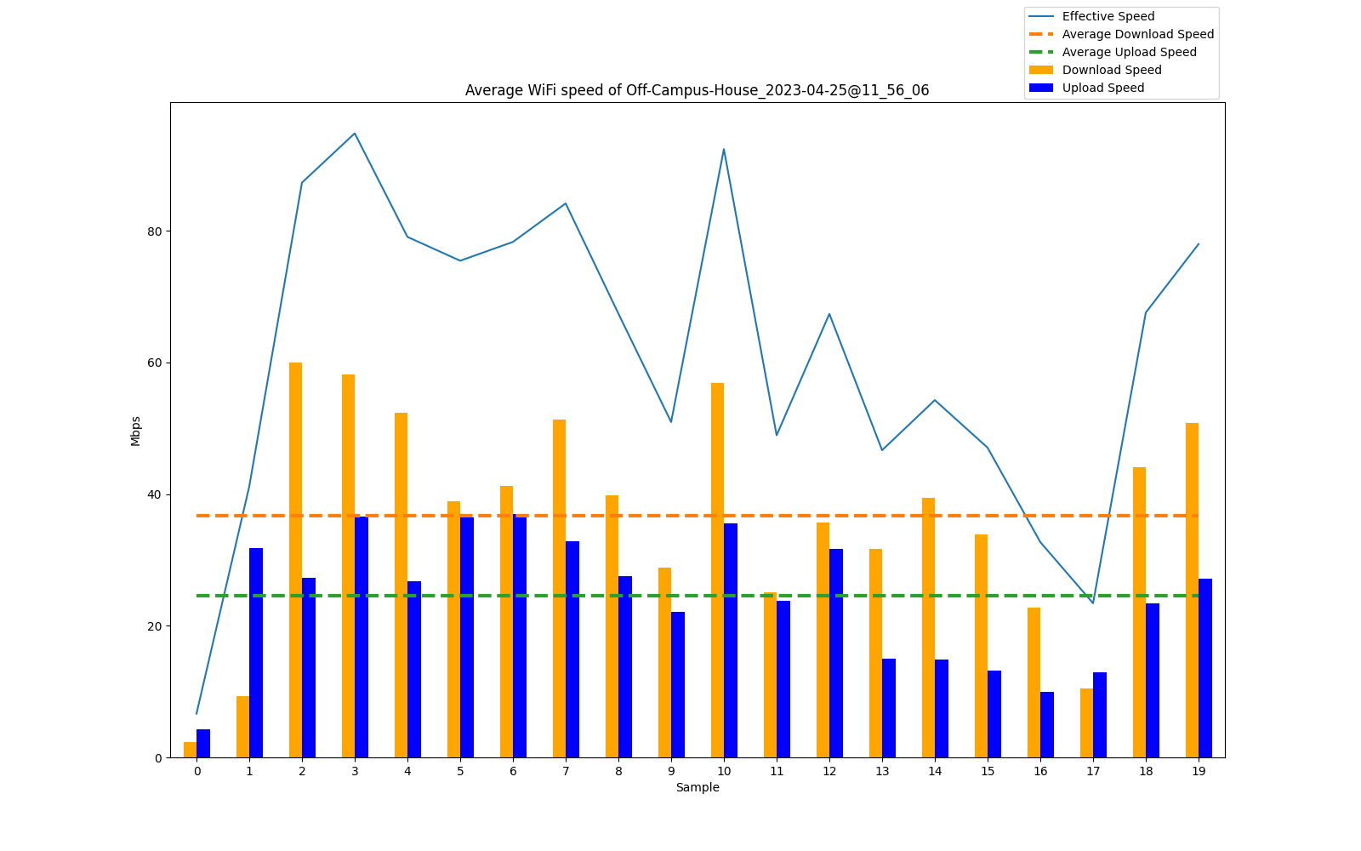
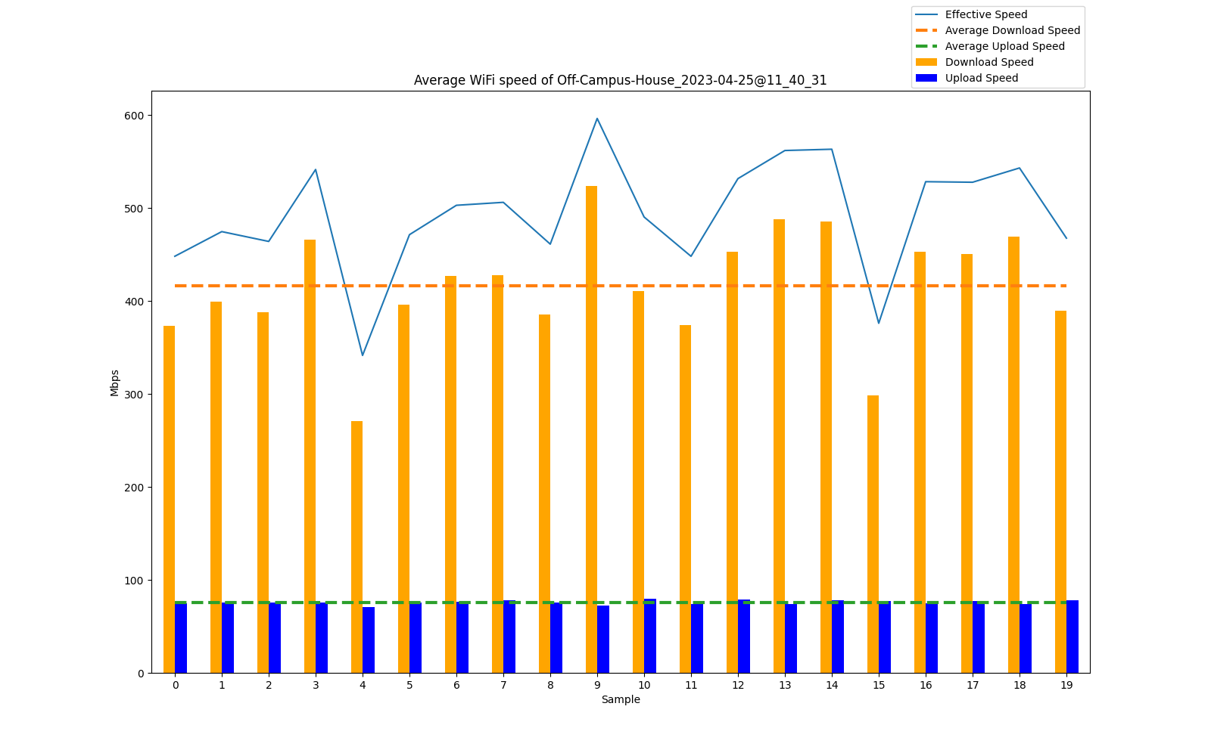
Off Campus - House
Figure 3a. Busy time
Figure 3b. Non-busy time
Notes:
isaac or beaudly

Slide 7
Trends & Observations
Busy Time Generally Slower
Evident at our house and at Klaus
Student Center was exception (possibly did not accurately estimate what "busy" time was)
Deviation from Average
The deviation from the average speed was generally higher for busy times
More Peaks & Troughs
During Busy Time!
Upload Speeds Always Slower
This is expected because hosts are not designed like routers to transmit data
Notes:
levi

Slide 8
Conclusions
Eduroam (campus wifi) designed for more users, less speed
Slower than home wifi, less variation between busy & not busy times
Home wifi designed for less users, more speed (paid network)
Faster than eduroam, more variation between busy & not busy times
Notes:
levi

